Slide 1
Digital Portfolio
STUDENT NAME: M.Dharshini
REGISTER NO AND NMID:212400993/ DFFE3782E39E436B4F248665B1C5E458
DEPARTMENT: Computer application
COLLEGE: UNIVERSITYS OF MADRAS

Slide 2
PROJECT TITLE
DIGITAL PORTFOLIO USING FRONT END WEB DEVELOPMENT.

Slide 3


AGENDA
Problem Statement
Project Overview
End Users
Tools and Technologies
Portfolio design and Layout
Features and Functionality
Results and Screenshots
Conclusion
Github Link
3/21/2024 Annual Review

Slide 4

PROBLEM STATEMENT
In today’s competitive digital world, it is often difficult to showcase one’s skills, projects, and achievements in a structured way. Without a clear platform, many students and professionals struggle to present their knowledge and capabilities effectively. This portfolio is created to solve that problem by providing a well-organized space to display my education, technical skills, projects, and certifications in a professional manner.

Slide 5

PROJECT OVERVIEW
“This project is a personal portfolio website designed to showcase my academic background, technical skills, projects, and certifications in an organized and professional way. It provides an easy-to-navigate platform where visitors can learn about my expertise in programming languages like HTML, CSS, C++, Python, and Data Structures. The portfolio highlights my journey as a BCA student and serves as a digital representation of my skills and achievements, helping me connect with future opportunities in the IT field.”

Slide 6

WHO ARE THE END USERS?
The end users of a portfolio are the individuals who interact with it to learn more about your background, skills, and accomplishments. They may include potential employers looking to evaluate your suitability for a job, recruiters who want to understand your strengths, teachers assessing your progress, or clients who wish to see examples of your work. In simple terms, end users are the people who benefit from your portfolio to make decisions about opportunities, collaborations, or learning outcomes.

Slide 7
TOOLS AND TECHNIQUES
I used tools like HTML, CSS, C++, Python, and Data Structures along with simple design techniques to create a responsive and user-friendly portfolio that highlights my skills and achievements.

Slide 8
POTFOLIO DESIGN AND LAYOUT
My portfolio has a simple, clean, and responsive layout with well-organized sections for easy navigation. It highlights my skills, education, and achievements in a structured way. The design ensures clarity, professionalism, and a smooth viewing experience.
‹#›

Slide 9
FEATURES AND FUNCTIONALITY
My portfolio features a clean design with sections like About, Skills, Education, Certifications, and Contact. It is responsive, easy to navigate, and highlights my information clearly with a professional look.

Slide 10
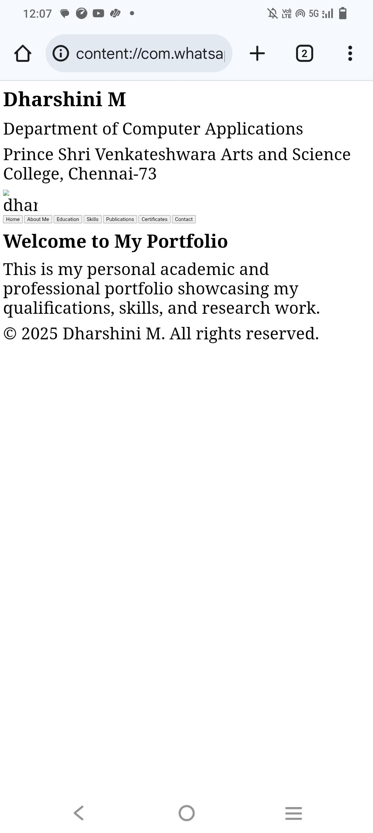
RESULTS AND SCREENSHOTS
My portfolio clearly presents my skills, education, and achievements in a professional way. It creates a positive impression and helps showcase my abilities effectively.
3/21/2024 Annual Review
‹#›

Slide 11
CONCLUSION
this portfolio serves as a reflection of my academic journey, technical skills, and personal achievements. It not only highlights my knowledge in programming and design but also shows my dedication to continuous learning and improvement. Through this portfolio, I aim to present myself as a motivated learner and future IT professional, ready to take on new opportunities and challenges.
‹#›

Slide 12
GITHUB LINK
https://13284bca2024-coder.github.io/DHARSHINI-/

